Slide 1
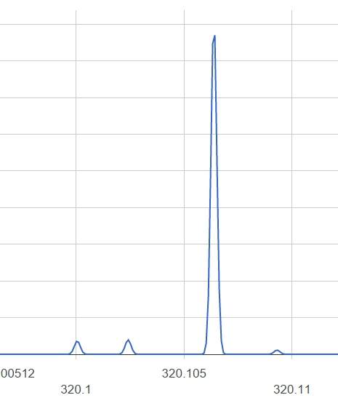
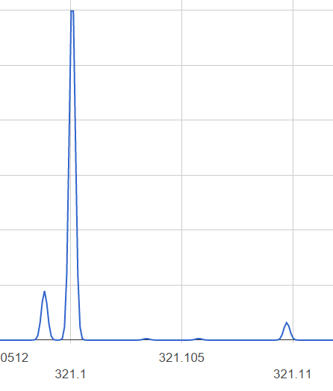
Exercise 2
¹³C <-> ¹⁵N
³⁷Cl <-> ³⁴S
¹³C <-> ³³S
¹³C <-> ²H
³⁷Cl <-> ¹³C, ¹³C

Slide 2
Exercise 2
So we know there is C, H, N, S, and Cl
No sign of O.

Slide 3
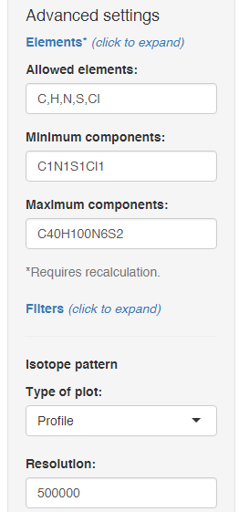
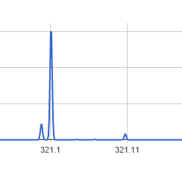
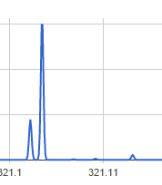
Exercise 2
Formula | Nitrogen rule | DBE | Calc. m/z | ppm | Ion | Adduct formula
C17H19N2SCl | Valid | 9 | 319.103 | 0.074 | [M+H]+ | C17ClH20N2S+
C19H20Cl2 | Valid | 9 | 319.1015 | -4.77 | [M+H]+ | C19Cl2H21+
C15H18N4S2 | Valid | 9 | 319.1046 | 4.92 | [M+H]+ | C15H19N4S2+
C16H24SCl2 | Valid | 4 | 319.1049 | 5.83 | [M+H]+ | C16Cl2H25S+
C14H23N2S2Cl | Valid | 4 | 319.1064 | 10.7 | [M+H]+ | C14ClH24N2S2+
C9H21N6Cl3 | Valid | 1 | 319.0966 | -20.1 | [M+H]+ | C9Cl3H22N6+

Slide 4
Exercise 2

